Slide 2
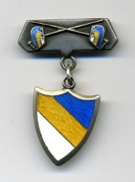
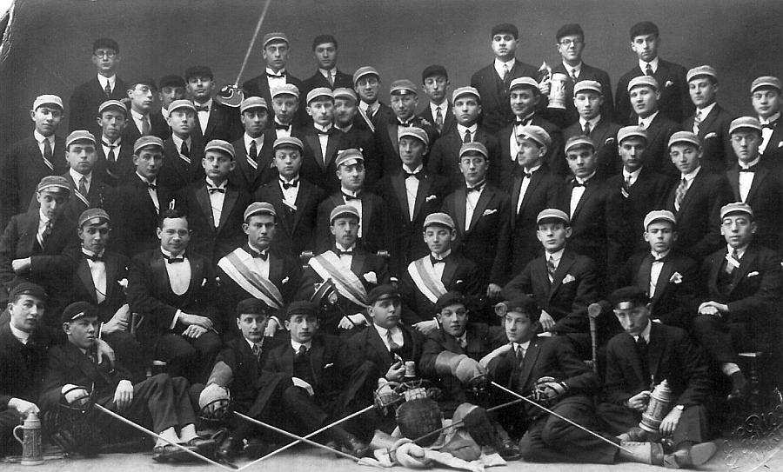
Hasmonea in 1927

Slide 3
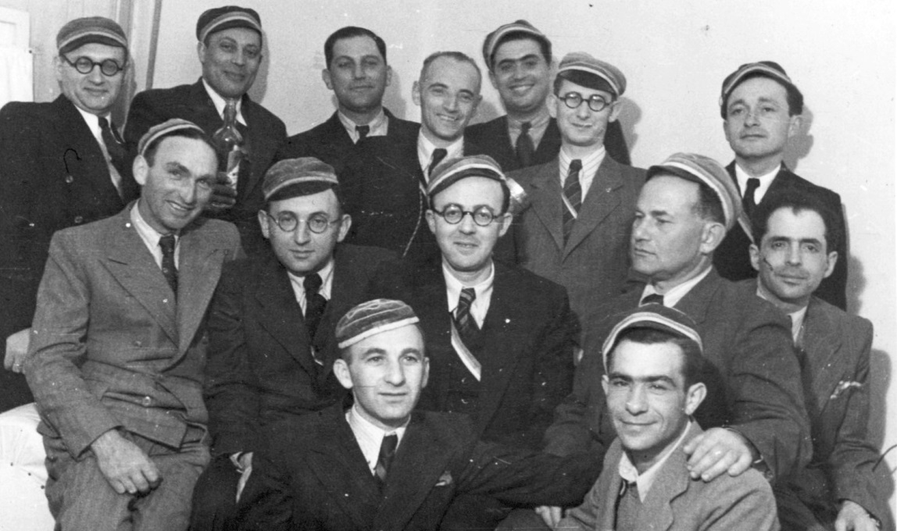
Hasmonea in 1943 in Palestine

Slide 4
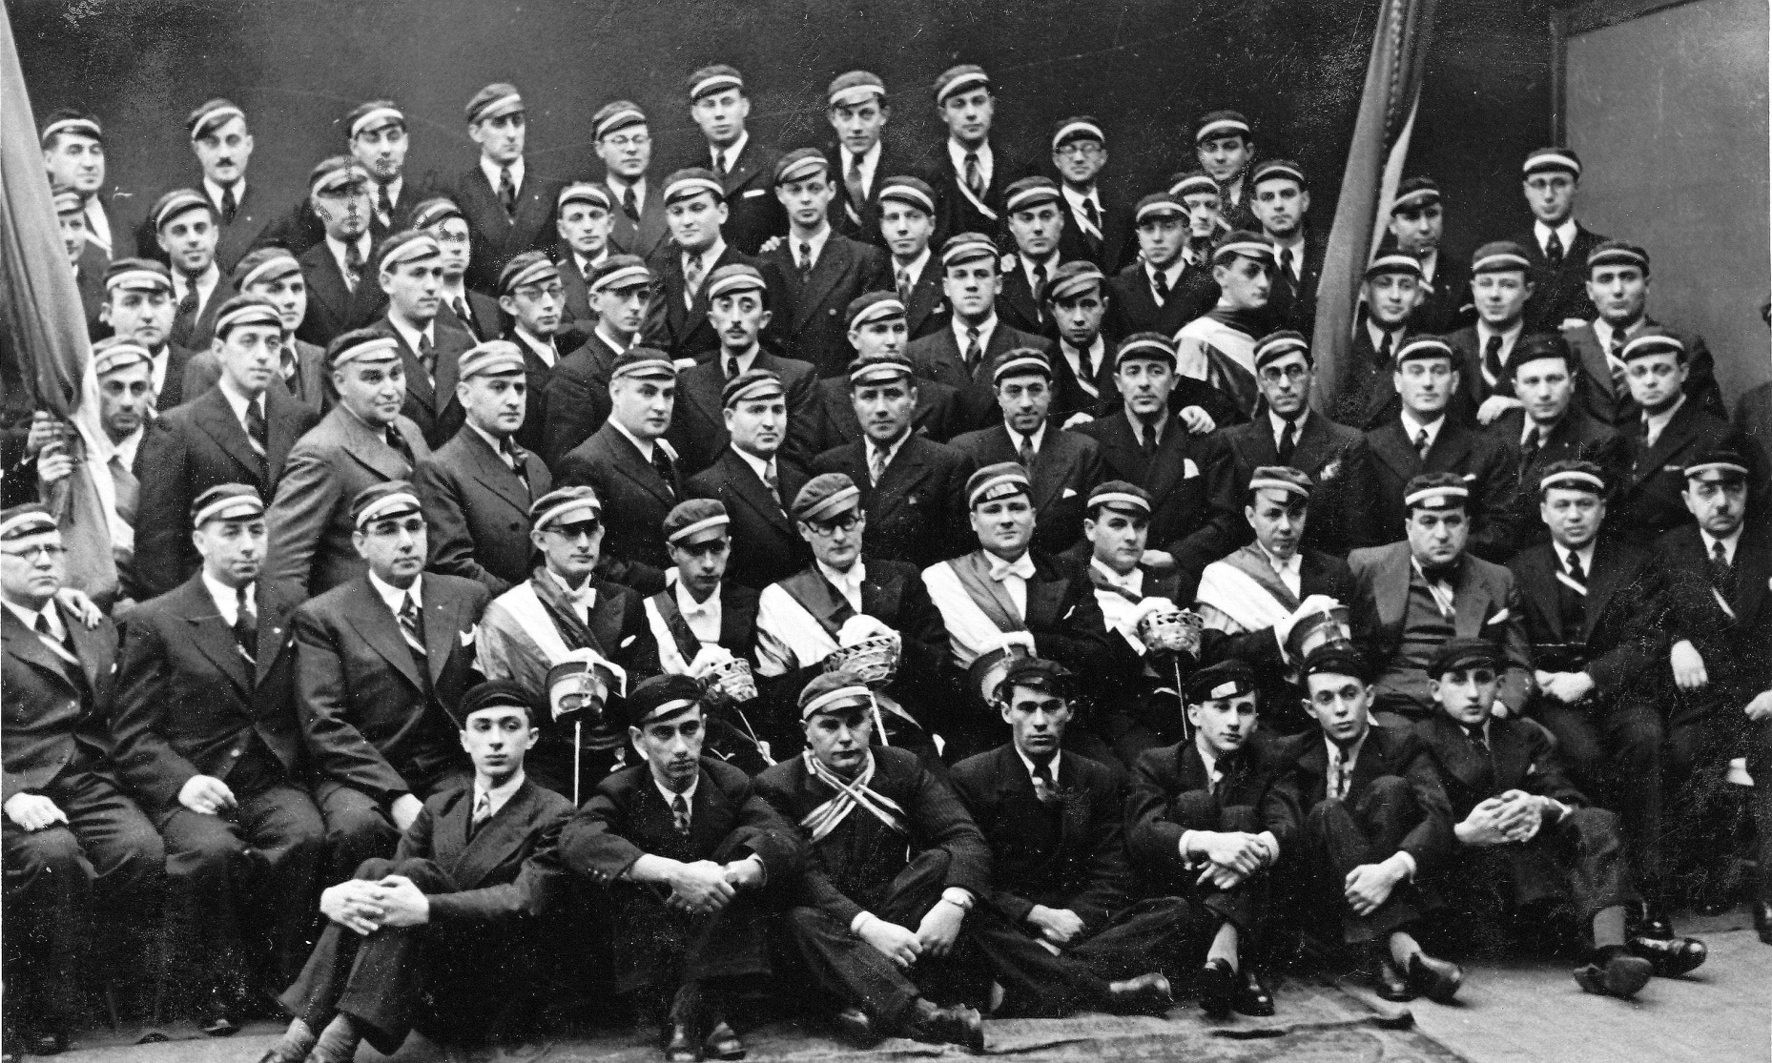
Limuvia in the 1930s

Slide 5
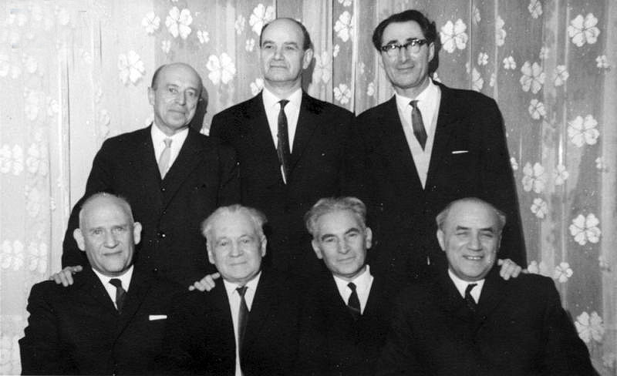
Limuvia in the 1960s in Tallinn

Slide 6
He’Halutz, Hachshara, Certificates
The emigration to Palestine from the Baltic countries was handled by the Palestinian Bureau in Riga who was in contact with the British consulate.
The entrance visas to Palestine (“the Certificates”) were given only to those who: - possessed a special knowledge or craft and were able immediately upon arrival to enter an existing company or business, or - had enough money to arrange their own business or enterprise.
All those, who didn’t answer the above criteria, could become candidates for Certificates after working in kibbutz Hachshara for two years and getting the recommendation from the group.
HeHalutz organization in Estonia was established in 1919 in Tartu by Leib Vilensky
Notes:
in Tartu

Slide 7
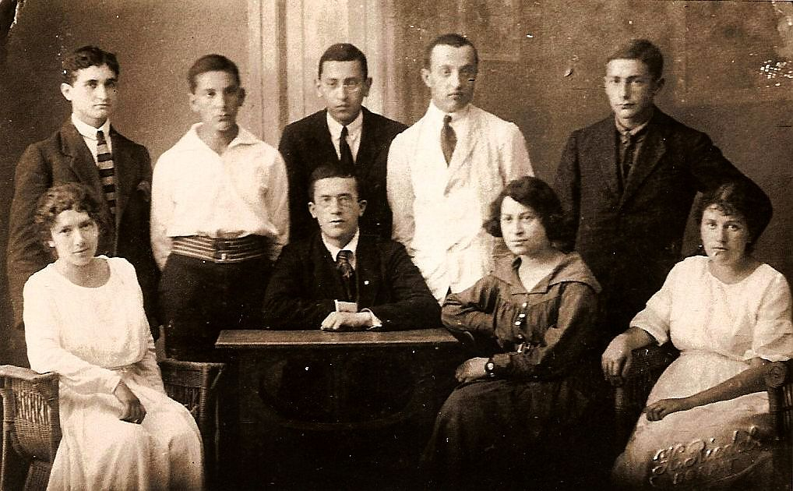
He’Halutz Tartu. 1921. Before aliyah of Ida Priver (Babst)
?
Moshe Sela (Selmanovitsch)
Nachum Gurevitsch
Ruven Selmanovitsch
Josef Goldberg
Ella Vilensky
Ethel Jakobson (Vilensky)
Leib Vilensky
Ida Priver (Babst)

Slide 8
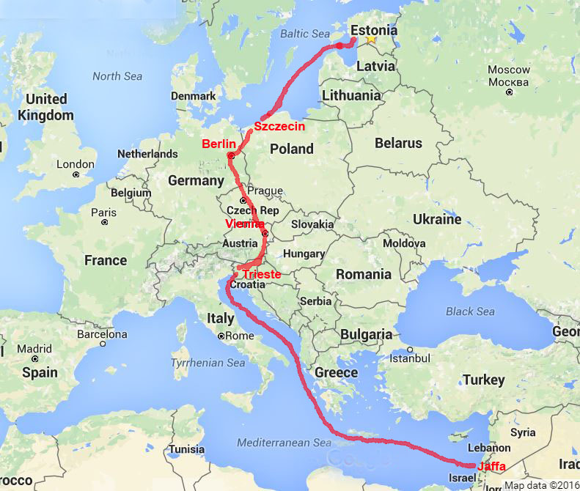
Planned route from Estonia to Palestine

Slide 9
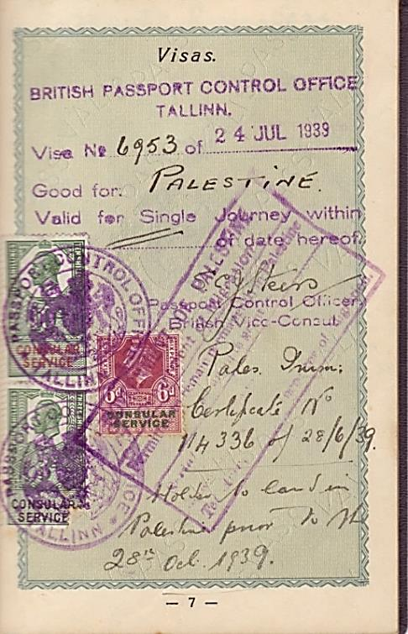
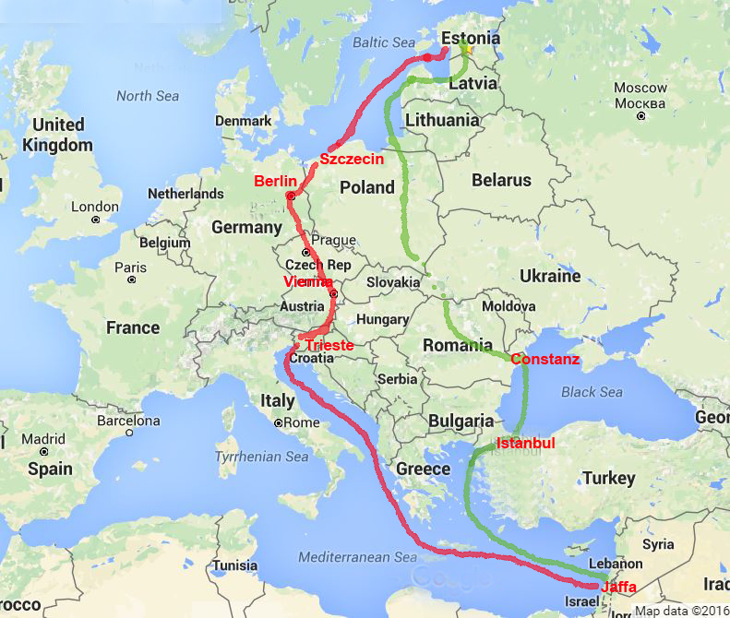
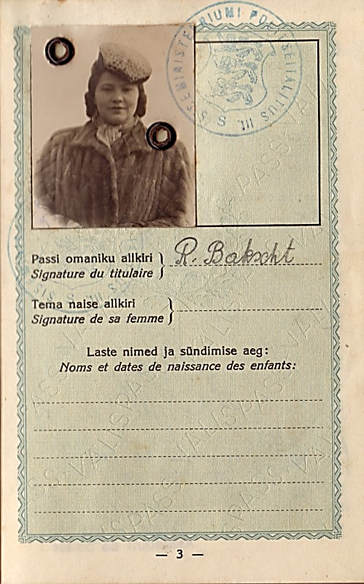
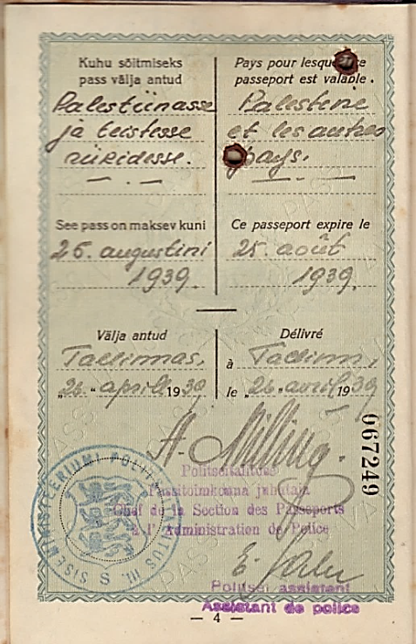
8.8.1939 Valka (Latvia) 8.8.1939 Poland (?)
9.8.1939 Constanz (Romania) 11.8 Istanbul (Turkey)
15.8.1939 Jaffa (Palestine)

Slide 10
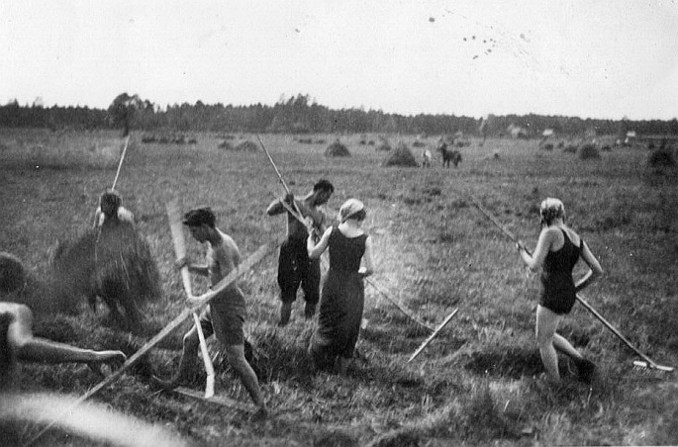
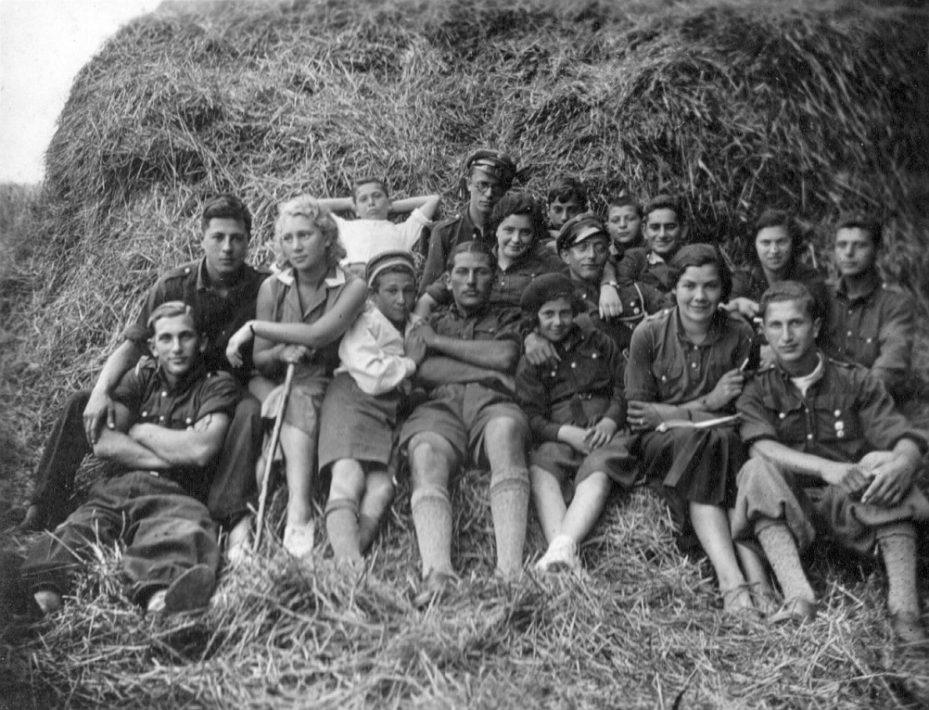
Hachshara
Sangaste 1935
Kurna 1935

Slide 11
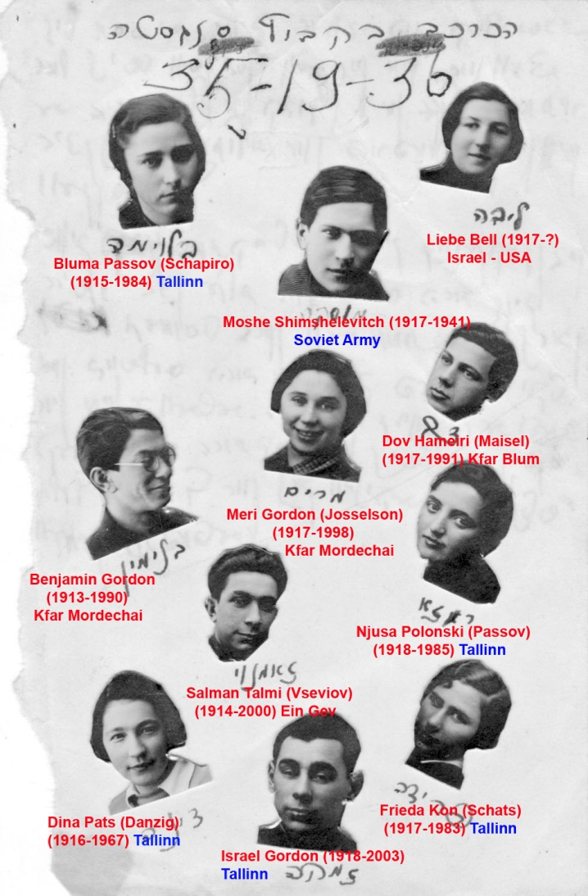
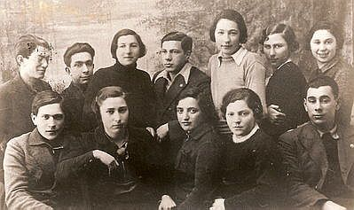
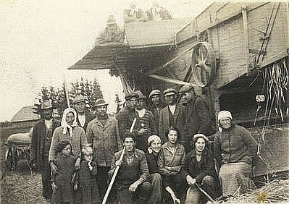
Sangaste, 1936

Slide 12
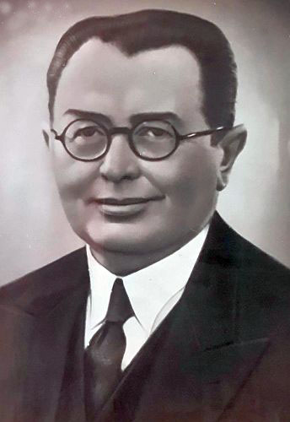
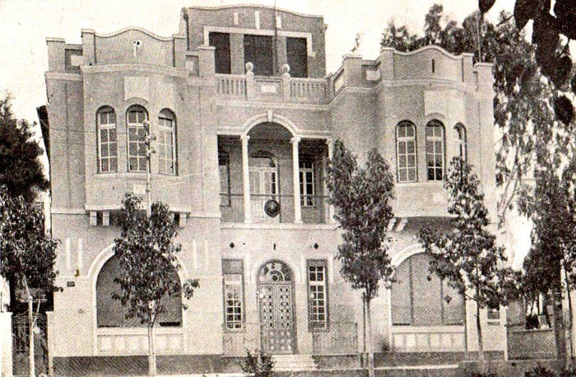
Maurice Litvinsky (1888-1952)
the Consul of Estonia in Palestine
(Today’s shield)
Ahad Ha’am 22,
Tel-Aviv

Slide 13
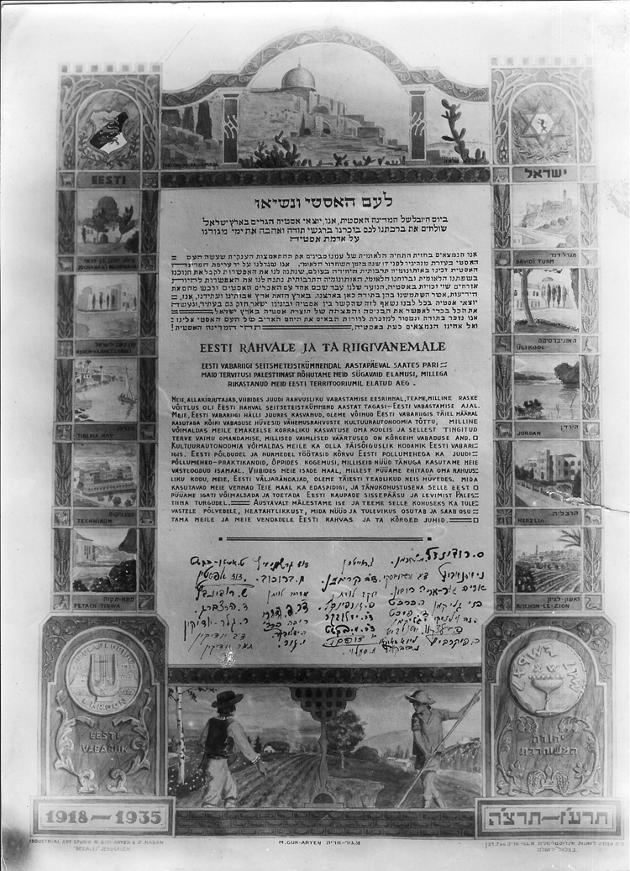
The letter to Estonian people and State Elder from the Estonian Jews living in Palestine. 1935.
Signed:
Tasja Amitan-Bakscht, David Epstein, Sh. Rubinovitsch, D. Herzberg, R. Geler-Judeikin, Dov Judeikin, Tamar Judeikin, David Gerschanovitsch, B. Boruhov, Abram Levitan, Dr Pasha Harary, Riva Harari, Riva Jadlovker, Jehoshua Gor, L. Haitin, Dov Krigman, Jacov Levit, P. Gurfinkel, Dr Jadlovker, Dr M. Bakscht, Dobkin, M. Smeloi, M. Lerenman, Dov Verschvinski, Dubin, R. Harchat, D. Ficht, I. Glickman, Asnovitsch, Lina ?, M. Bobkovitsch, S. Rudindel?, N. Asnovitsch, Arie Gur-Arie, Fani Glickman, Henia Vilenski, P. Balzakov, R. Pikarevitsch, Asnovitsch

